Slide 1
Κατανεμημένα Συστήματα
Bitcoin and Blockchain
2018-2019
http://www.cslab.ece.ntua.gr/courses/distrib
Notes:
1

Slide 2
Blockchain Defined
Simply defined a Blockchain is little more than a:
Distributed
Secure
Ledger (logfile)
A digital currency was in a lot of ways the first demonstrable use

Slide 3
What is Bitcoin
A protocol that supports a decentralized, pseudo-anonymous, peer-to-peer digital currency
A publicly disclosed linked ledger of transactions stored in a blockchain
A reward driven system for achieving consensus (mining) based on “Proofs of Work” for helping to secure the network
An economy with an eventual cap of about 21M bitcoins

Slide 4
Bitcoin Whitepaper – 2008.10.31
* Halloween

Slide 5
Features of Bitcoin
Essentially it’s “deflationary” – the reward is cut in half every four years
Nearly infinitely divisible currency units supporting eight decimal places 0.00000001 (known as a Satoshi)
Nominal transaction fee’s paid to the network
Same cost to send $.01 as $1,000,000
Consensus driven – no central authority
Counterfeit resilient
Cannot add coins arbitrarily
Cannot be double-spent
Non-repudiation – aka “gone baby gone” – no recourse and no one to appeal to return sent tokens

Slide 6
When did it start?
“Satoshi Nakamoto” created the reference implementation that began with a Genesis Block of 50 coins
2008
August 18 Domain name "bitcoin.org" registered^{[1]}.
October 31 Bitcoin design paper published
November 09 Bitcoin project registered at SourceForge.net
2009
January 3 Genesis block established at 18:15:05 GMT
January 9 Bitcoin v0.1 released and announced on the cryptography mailing list
January 12 First Bitcoin transaction, in block 170 from Satoshi to Hal Finney
https://en.bitcoin.it/wiki/History

Slide 7
Why does it have value?
The worth of a thing
is the price it will bring.

Slide 8
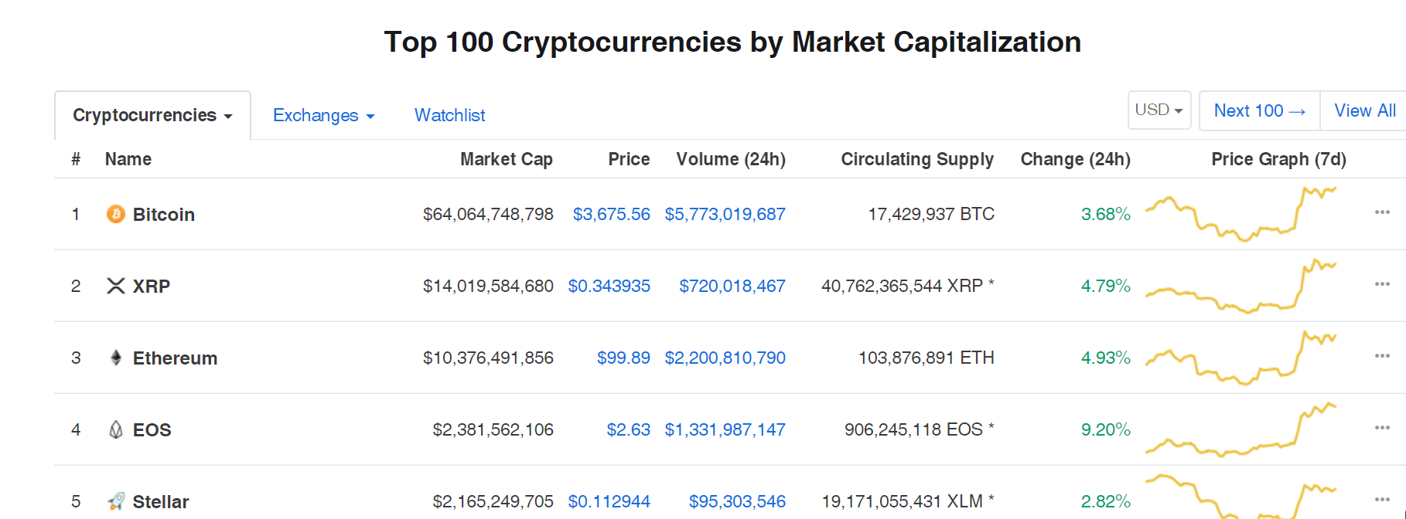
Why does it matter?
16 Billion Dollar Market Cap!
http://coinmarketcap.com

Slide 9
BitCoin: Challenges
All virtual currency must address the following challenges:
Creation of a virtual coin/note
How is it created in the first place?
How do you prevent inflation? (What prevents anyone from creating lots of coins?)
Validation
Is the coin legit?
How do you prevent a coin from double-spending?
BitCoin takes a infrastructure-less approach
Rely on proof instead of trust
No central bank or clearing house

Slide 10
BitCoin: Motivation
Rely on proof instead of trust
Current online transactions rely on a trusted party (e.g, VISA)
They take some risk, manage fraud, and get paid a fee.
Buyer and Seller protection in online transcations
Buyer pays, but the seller doesn’t deliver → Solved by using an escrow (Buyer protection)
Seller delivers, buyer pays, but the buyer makes a claim. VISA refunds; the payment is reversed. Either the seller is penalized and/or VISA charges more fee to handle these cases. Some behaviors are fraudulent.
BitCoin gets rid of this trusted middleman, by being able to directly show the cryptographic proof that the money is transferred.

Slide 11
Four components in secure communication
Authentication
Confidentiality
Integrity
Availability

Slide 12
What do we want to secure?
Authentication (Who am I talking to?)
Identification and assurance of the origin of information
Confidentiality (Is my data hidden?)
Concealment of information
Integrity (Has my data been modified?)
Prevent improper and unauthorized changes
Availability (Can I use the resources?)
The ability to use the information or resource desired
Notes:
We will talk about the first three of these things today… availability we must tolerate failures and assume network gives us some guarantee

Slide 13
From the perspective of BitCoin
Authentication
Am I paying the right person? Not some other impersonator?
Integrity
Is the coin double-spent?
Can an attacker reverse or change transactions?
Availability
Can I make a transaction anytime I want?
Confidentiality
Not very relevant. But privacy is important.

Slide 14
From the perspective of BitCoin
Authentication → Public Key Crypto: Digital Signatures
Am I paying the right person? Not some other impersonator?
Integrity → Digital Signatures and Cryptographic Hash
Is the coin double-spent?
Can an attacker reverse or change transactions?
Availability
Can I make a transaction anytime I want?
Confidentiality
Not very relevant. But privacy is important.

Slide 15
Cryptographic Hash Functions
Consistent: H(X) always yields same result
One-way: given Y, hard to find X s.t. H(X) = Y
Collision resistant: given H(W) = Z, hard to find X such that H(X) = Z
Hash Fn
Message of arbitrary length
Fixed Size
Hash
e.g. SHA256 ->256 bits

Slide 16
Collision resistant
Find a collision:
Try 2¹³⁰ randomly chosen inputs
99,8% chance that two of them collide
Takes too long to matter

Slide 17
SHA256
In practice, we hope that SHA256 behaves “like a random oracle”.
$$\text{SHA}\text{256}:\text{TextFiles}→\left\{0,…,2^{256}−1\right\}$$
Calculation: If we made all computers in the world compute $\text{SHA}\text{256}$…
It takes ~“$40×14⋅{10}^{9}$ years” to find $x_{1}≠x_{2}$ s.t.
$$\text{SHA}256\left(x_{1}\right)=\text{SHA}256\left(x_{2}\right).$$

Slide 18
Application: Hash as a message digest
H(x) = H(y) then safe to assume x=y
To recognize a file that we saw before, just remember its hash
Useful because it’s small

Slide 19
One way
Given H(x), infeasible to find x
Distributions of values should be very spread out (e.g., uniform)

Slide 20
Digital Signature
Signing
Verification
Key Generation
Bob
Alice (Public)
Alice (Secret)
Alice

Slide 21
Digital Signature
Signing
Verification
Key Generation
Alice (Public)
Alice (Secret)
Alice (Public)
Bob
Alice

Slide 22
Digital Signature
Goal: Bob should be sure that the message originates from Alice.
Signing
Verification
Key Generation
Alice (Public)
Bob
Message
Alice (Public)
Alice (Secret)
Alice
A

Slide 23
Digital Signature
Key Generation
Secret Key
Message
Public Key
Secret Key
Signing
Message
A
Public Key
A
Verification
Security (informal): You cannot produce valid signatures without the secret key.

Slide 24
Back to BitCoins
Validation
Is the coin legit? (proof-of-work) → Use of Cryptographic Hashes
How do you prevent a coin from double-spending? → Broadcast to all nodes
Creation of a virtual coin/note
How is it created in the first place? → Provide incentives for miners
How do you prevent inflation? (What prevents anyone from creating lots of coins?) → Limit the creation rate of the BitCoins

Slide 25
Attempt #1
We now try to build bitcoin…
… but we will fail.

Slide 26
Goals
We want some kind of “digital money”.
Everyone can participate.
No central instance – no bank.
Notes:
10 min so far.

Slide 27
Setting
A network of computers.
Every computer can send messages to some other computers.

Slide 28
Basic idea
Every computer maintains a table: “who owns what?”
Alice (Public)
10 BTC
Bob
(Public)
0.2 BTC
We will need: all computers have the same table.
Charlie
(Public)
17 BTC
Dora
(Public)
0.001 BTC
Eliza
(Public)
2 BTC
Remark: The public keys are just bit strings.

Slide 29
Sending Bitcoins
To send money, we use transactions. These are messages like this:
Transfer
0.1 BTC
from
Alice (Public)
In “short”, transactions look like this:
to
Bob
(Public)
$
F
T
A

Slide 30
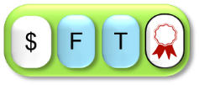
Main Transaction pic
$
F
T
$
F
T
*

Slide 31
Sending Bitcoins
I’LL send 0.1 Bitcoin to Bob.
$
F
T
Alice
Protocol: sending BTC
Craft a transaction.
Give it to your computer.
Protocol: participating
On valid transactions:
Update ledger
Relay transaction

Slide 32
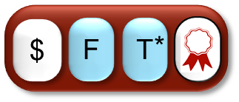
Double Spending
Thanks!
I can exploit this!
These transactions spend previously spent bitcoins!
Bob
Thanks!
Black Hat
Black Hat prepares two transactions:
Alice
: Give BTC from Black Hat to Alice
: Give BTC from Black Hat to Bob

Slide 33
Double Spending
The bad guy spends the same Bitcoins with two different transactions and .
Computers receiving transaction will have a different ledger than computers receiving transaction .

Slide 34
Consensus Protocols
We need a protocol to agree on a transaction.
“Consensus protocols”. Studied since 1980, starting with Pease, Shostak, Lamport.
Huge literature!
Main idea for protocols:
What transaction are you using?
Protocols work if (say) > 70% of the computers follow the protocol.

Slide 35
This solution does not help us!
Design goal:
Everyone can participate.
By running a special program, a bad guy controls many virtual computers.
Like this, he can make different participants believe different things.
I will gladly participate…
With 1 000 virtual machines!

Slide 36
Bitcoin’s consensus protocol
Step 1: How does the protocol look like?
Step 2: What happens if people cheat?

Slide 37
BitCoin
Electronic coin == chain of digital signatures
BitCoin transfer: Sign(Previous transaction + New owner’s public key)
Anyone can verify (n-1)th owner transferred this to the nth owner.
Anyone can follow the history
given a BitCoin

Slide 38
Blocks
A block $B$ contains
$\text{R}\text{H}(B′)$ for another block $B′$,
a list of transactions,
and an arbitrary number “nonce”.
0000031105830
8046465385222
Block $B$ is valid if the first $d=5$ digits of the hash of $B$ are all zero.
RH
0000077326777

Slide 39
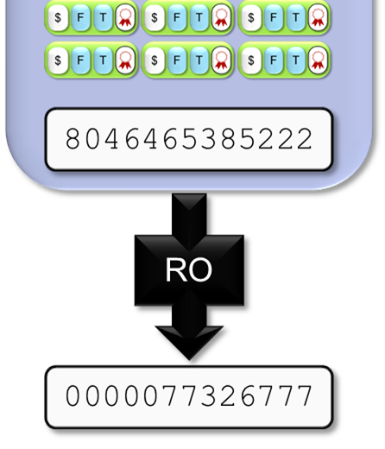
Blocks
To find a valid block, we try different values for this string (“nonce”).
On average, after ${10}^{d}=100000$ tries, we find a valid block.
Bitcoin chooses $d$ on the fly such that this takes about 10 minutes.
Block $B$ is valid if the first $d=5$ digits of $\text{RO}\left(B\right)$ are all zero.

Slide 40
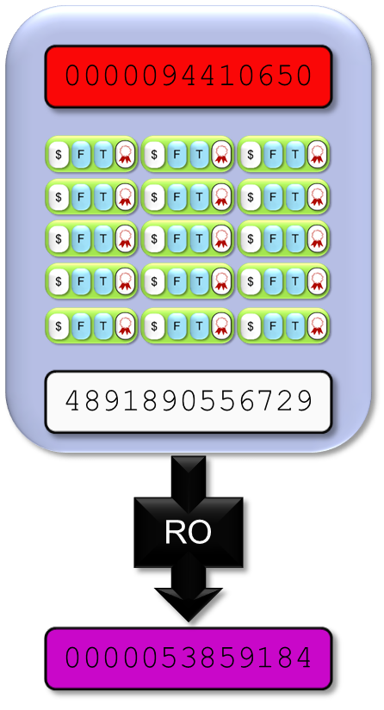
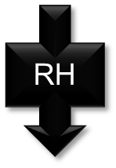
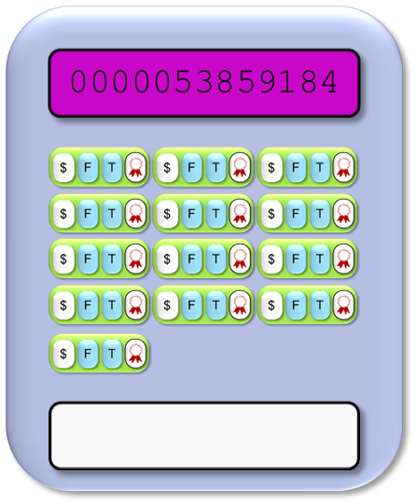
Blocks
If we have a block, we can find a “next block”:
Take $\text{RH}(B′)$ from the previous block$B′$. Add transactions.
$$=$$
Try different values for this string until the hash starts with $d$ zeros.
Notes:
Remark: same color: same string (but should be clear even if you can’t see the color)

Slide 41
BitCoin Network
Each P2P node runs the following algorithm [bitcoin]:
New transactions are broadcast to all nodes.
Each node collects new transactions into a block.
Each node works on finding a proof-of-work for its block. (Hard to do. Probabilistic. The one to finish early will probably win.)
When a node finds a proof-of-work, it broadcasts the block to all nodes.
Nodes accept the block only if all transactions in it are valid (digital signature checking) and not already spent (check all the transactions).
Nodes express their acceptance by working on creating the next block in the chain, using the hash of the accepted block as the previous hash.

Slide 42
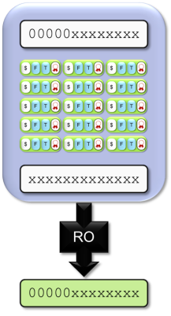
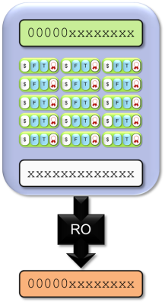
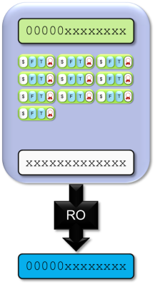
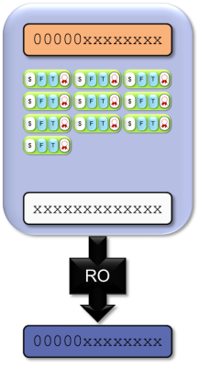
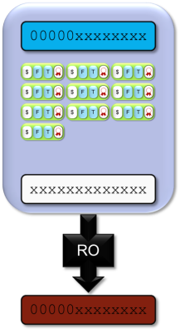
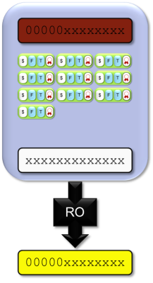
A Tree of Blocks
If we have a block, with a bit of work, we can find a “next block”…
$$=$$
...and yet another “next block”…
…or a block which continues here…
… and so on.
Notes:
Remark: same color: same string (but should be clear even if you can’t see the color)

Slide 43
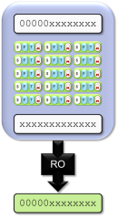
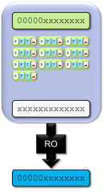
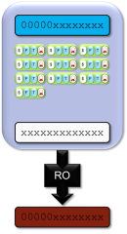
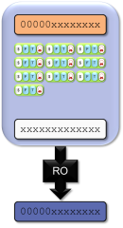
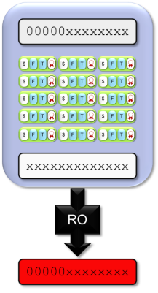
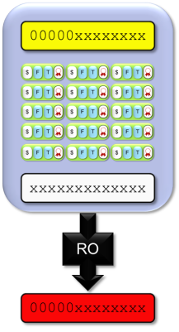
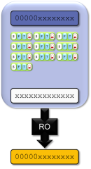
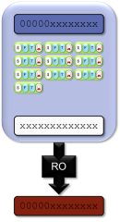
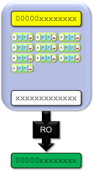
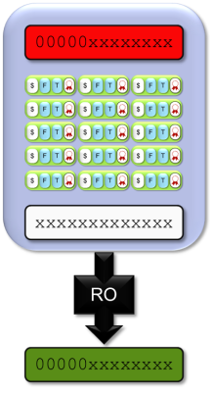
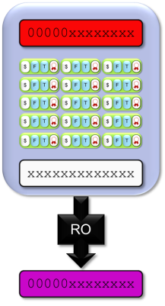
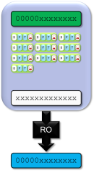
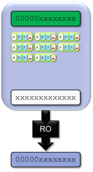
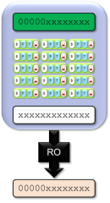
A Tree of Blocks
In general, we can build a tree of blocks like this.
But only ever downwards!

Slide 44
Tie breaking
Two nodes may find a correct block simultaneously.
Keep both and work on the first one
If one grows longer than the other, take the longer one
Two different block chains (or blocks) may satisfy the required proof-of-work.

Slide 45
The Protocol for Finding Blocks
Protocol: finding blocks
Take the longest chain you can find.
Collect transactions.
Find a new valid block here.
Publish it.

Slide 46
The Protocol for Participants
Protocol: To know who owns BTC
Take the longest chain you can find.
Process the transactions in this chain in order.

Slide 47
Reverting is hard…
Reverting gets exponentially hard as the chain grows.
2. Recompute nonce
3. Recompute the next nonce
1. Modify the transaction (revert or change the payer)

Slide 48
Practical Limitation
At least 10 mins to verify a transaction.
Agree to pay
Wait for one block (10 mins) for the transaction to go through.
But, for a large transaction ($$$) wait longer. Because if you wait longer it becomes more secure. For large $$$, you wait for six blocks (1 hour).

Slide 49
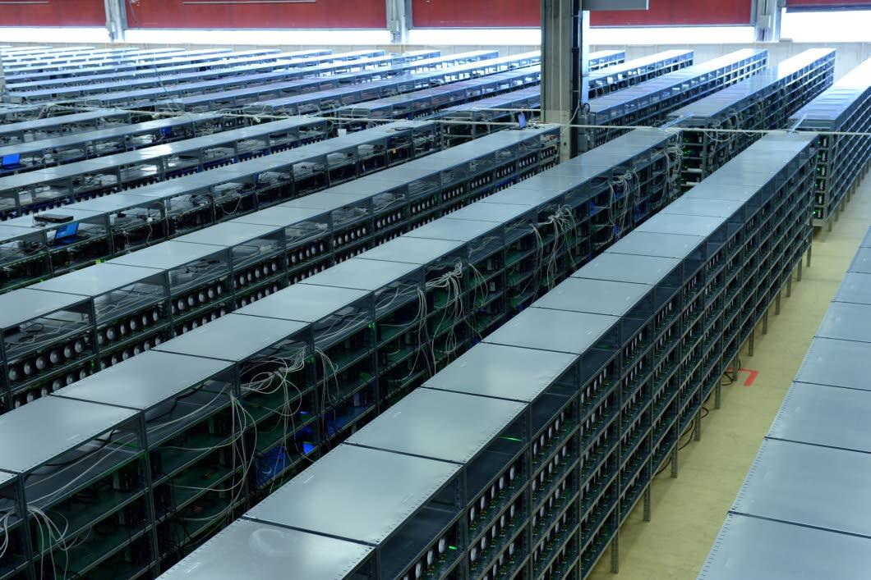
Why work to find blocks?
Many people are trying to find blocks, which uses a lot of resources…
A real lot!
This is called “mining”.

Slide 50
Block reward
If you find a block, you get bitcoins as a reward.
Every transaction specifies a fee. It goes to the person who puts the transaction into a valid block.
0.1 BTC
Transfer
0.1 BTC
Transfer
Alice (Public)
from
Alice (Public)
from
Bob
(Public)
to
Bob
(Public)
to
A
0.001 BTC
Fee:
A

Slide 51
Recap: The Bitcoin Protocol
Protocol: participate
Relay valid transactions.
Relay valid blocks in the longest chain.
Work with the longest chain.
Protocol: miners
Collect valid transactions.
Publish valid blocks which extend the longest chain.

Slide 52
Bitcoin’s consensus protocol
Step 1: How does the protocol look like?
Step 2: What happens if people cheat?

Slide 53
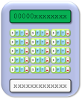
Double Spends
I found a valid block!
I can exploit this!
Bob
Black Hat
Once a block is found, the double spends vanish.
Alice
Occasionally, two people find blocks at around the same time… but typically the problem disappears.
Notes:
Mention: block finding time ~10m -> we can distribute before a new block is found

Slide 54
Build an Alternate Chain?
Maybe I should build another chain?
Notes:
Mention: if most people are honest, it should mean that good things happen.
Mention: Theorem due to Garay, Kiayias, Leonardos (Oct 2014) shows: if most hashpower is devoted to honest parties, good things happen.
USE MOUSE FOR NEXT SLIDE

Slide 55
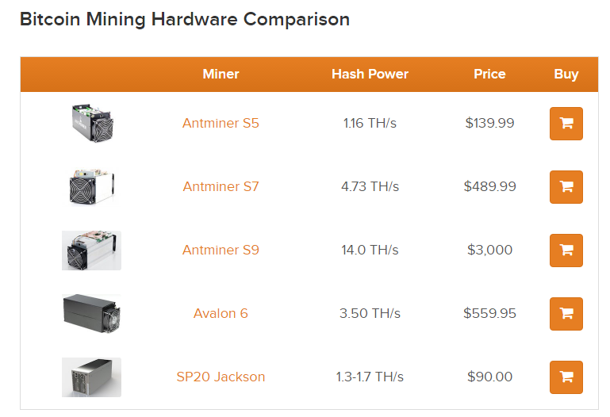
Hardware War

Slide 56
Summary
BitCoin combined techniques from crypto and the right incentives.
Nice design
A trait for popular systems
BitCoin is becoming industrialized.
Miners form a pool.
Mining hardware becomes sophisticated.
BitCoin exchange
Derivative market, etc.
Government agencies are keeping an eye on them.
Who will control BitCoin in the end?

Slide 57
More uses of blockchain?
If the blockchain technology works, it gives a new consensus algorithm. What else can we use it for?
Ideas:
Multiparty computation protocols based on the blockchain.
Timestamping
Crowdfunding
Have your shares in the blockchain
Smart payments
etc…
Notes:
Lots of ideas from http://bitcointalk.org

Slide 58
References
Bitcoin and Cryptocurrency Technologies, Arvind Narayanan, Joseph Bonneau, Edward Felten, Andrew Miller, Steven Goldfeder
Bitcoin: A primer by François R. Velde, senior economist FRB
Bitcoin: A Peer-to-Peer Electronic Cash System, Satoshi Nakamoto
http://bitcoinbook.cs.princeton.edu/

